Slide 1
Mobile Augmented Reality
Using QR codes to provide a social augmented reality framework

Slide 2
Augmented Reality - Overview
Enhancing the physical world with virtual data
Can take many forms
A 3D digital layer that appears as part of the physical world
A simple information overlay that provides additional information

Slide 3
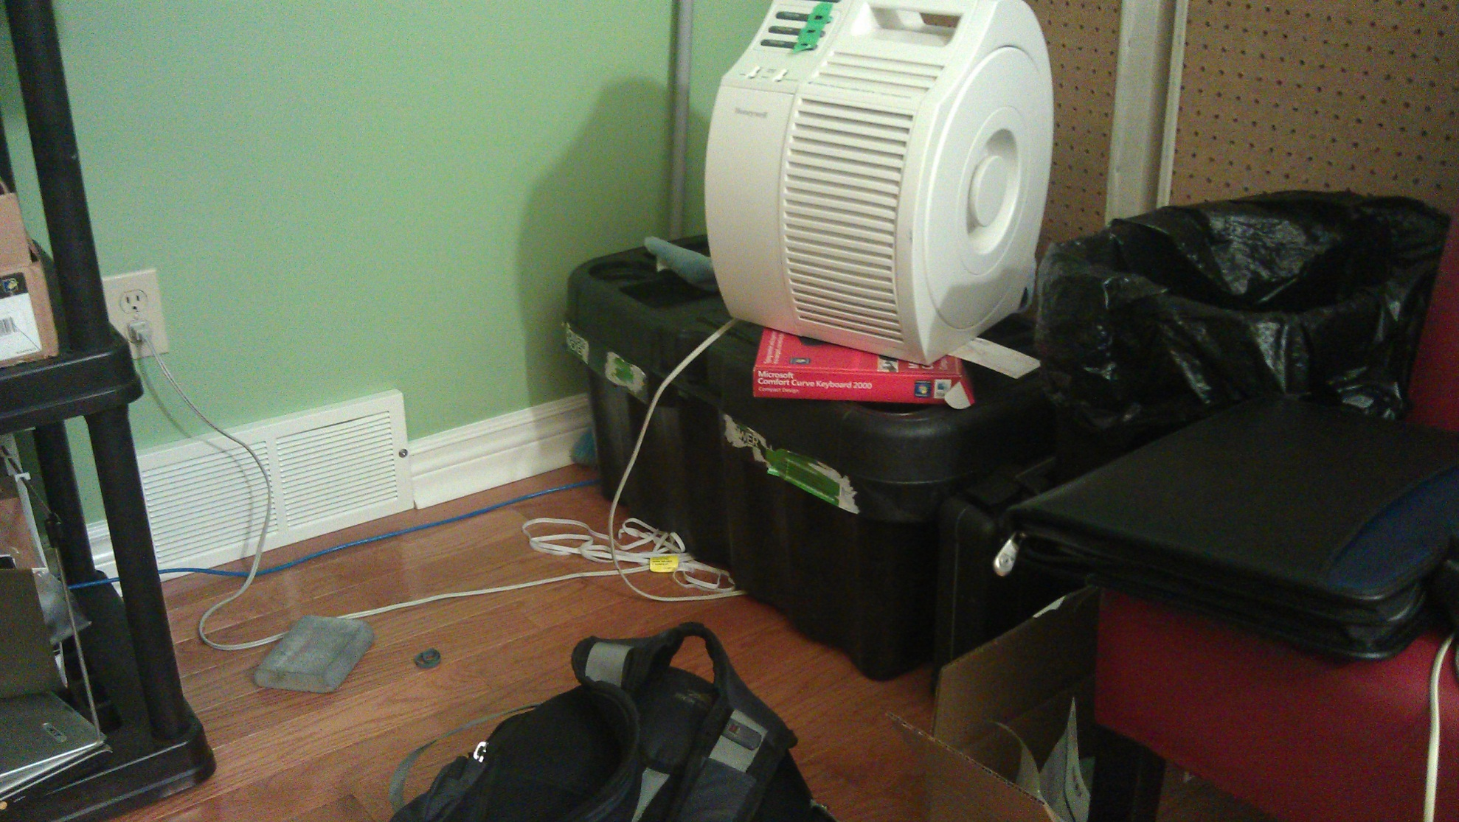
Reality

Slide 4
Augmented Reality

Slide 5
Outline
Each QR code corresponds with a set of augmented reality data (i.e. 3D models)
This data can be further defined using location, allowing the same code to correspond with a different set of objects if viewed at a different location
Content creation is done real time by users
AR objects can be added, deleted and moved using the smartphone
Multiple users can interact with a data set simultaneously
Notes:
For example, a QR code in on a billboard at one location would display a different image than the same code at another location

Slide 6
Project Objectives
Accessible
Runs on the majority of recent smartphones
Interactive
Uses smartphone as a physical “cursor”
Universal
Will work on any QR code, anywhere in the world
Notes:
The goal of this project was to create an augmented reality system with the following properties

Slide 7
Why use QR codes?
QR codes are commonly used throughout society
Standardized format
Contain patterns that can be easily tracked
Positioning and identification at the same time

Slide 8
How it works
Find a QR code
Send the data to the server
Server sends back augmented reality data
Track the QR code to determine device’s precise location
Use data from internal gyroscope to approximate orientation if QR code leaves camera view

Slide 9
DEMO

Slide 10
The Design
The application operates as follows:
Uses video stream from smartphone camera to locate QR codes
Sends present location (GPS) along with text embedded in code to a server
Server provides augmented reality data to smartphone
Smartphone overlays 3D objects on camera image, relative to QR code

Slide 11
Tracking
QR code has known dimensions and content
Properties of camera, such as field of view and distortion are known from calibration
Locate specific features, then determine rotation and translations required to move from image space to QR code space

Slide 12
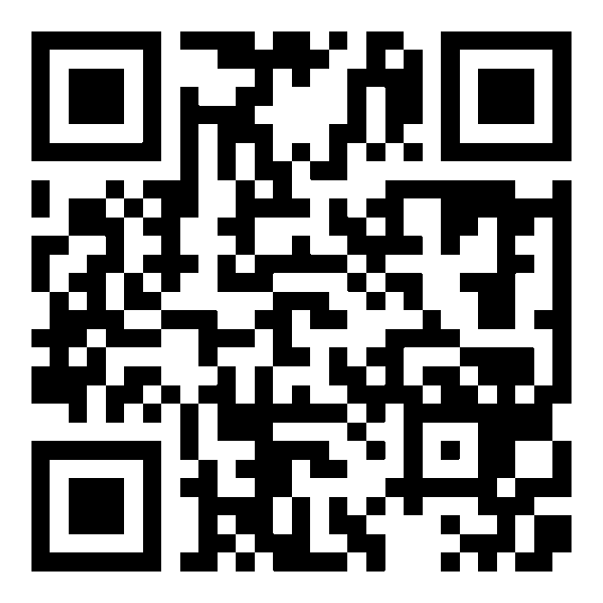
Tracking
Finder patterns and alignment patterns are present in all QR codes
Finder Patterns
Alignment Pattern

Slide 13
Tracking
Finder patterns and alignment patterns are present in all QR codes
Corners of these features are used for tracking
Finder Patterns
Alignment Pattern

Slide 14
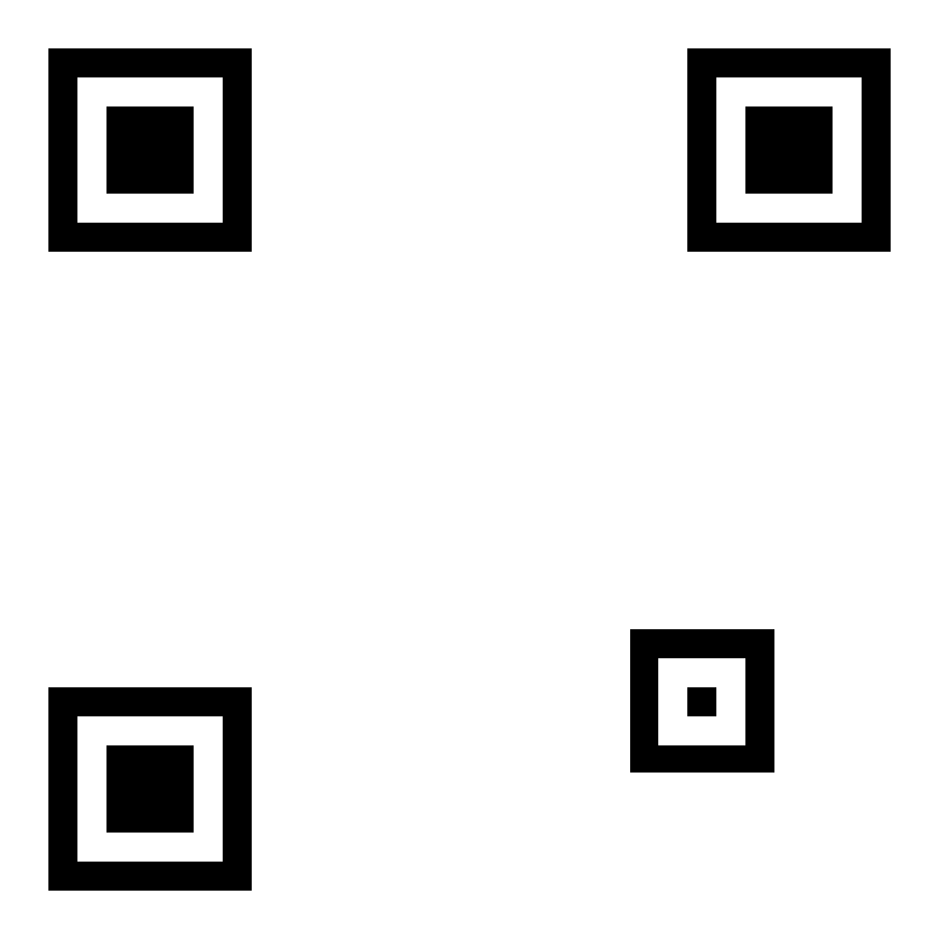
Tracking
During tracking, the QR code’s data is ignored
Detect edges by using gradients in grayscale image
Once patterns are detected, the FAST corner detection algorithm is used to precisely locate corners
This combination of edges and points provides fast and accurate tracking

Slide 15
Positioning
Map features found in image to features in QR code
Solve for rotation and translation matrix that will map known features to image features
$$P_{image}=P_{object}∗Camera∗Rotation∗Translation$$

Slide 16
Positioning
Once rotation and translation matrices are known, they are used to transform 3D objects to QR code’s coordinate system

Slide 17
QR Code decoding
Many QR code detection systems rely on image thresholding
This can be unreliable, as bright spots in the background can be shift the threshold point higher
Solution: Detect on grayscale image using gradients, then do localized thresholding

Slide 18
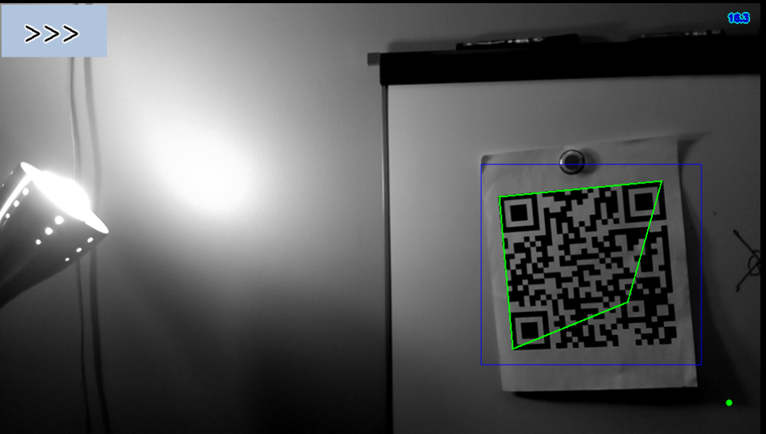
Grayscale Detection

Slide 19
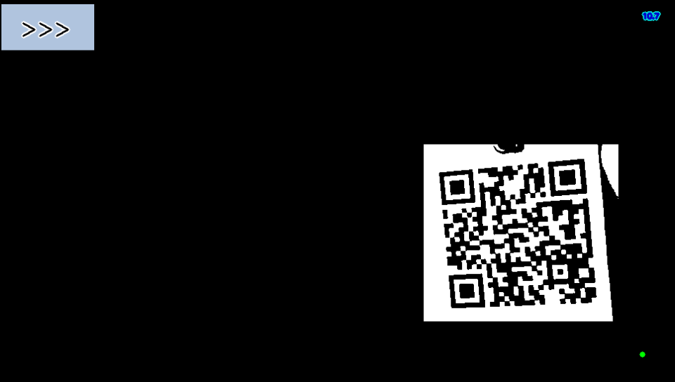
Localized Thresholding

Slide 20
Interaction

Slide 21
Implementation
Application is implemented on Android OS v2.3
Majority of logic implemented in Android NDK (native development kit), which allows Android applications to execute native C++ on the processor.
This can provide significant performance benefits
Uses OpenCV, a popular open-source image processing library

Slide 22
Challenges
Minimal documentation for native Android code
Camera parameters such as focus and frame rate are not adjustable from native code
QR codes were more challenging to track than expected, as they contain many repeating patterns that can confuse tracking algorithms
Tracking accuracy limits range that virtual objects can be from QR code

Slide 23
State of the art
Types of AR – Differentiated by method of locationing
Large scale, uses GPS and compass
Medium scale, uses terrain data or precise localized GPS system.
Small scale, uses cameras to determine position relative to a known image or object
Examples
QCAR
AR Quake
LAYAR

Slide 24
Applications
QR codes are common throughout society
Any QR code can host augmented objects
Use cases:
Advertising
Interactive games
Information sharing

Slide 25
Advertising
Enhance advertisements by adding 3D models
Location-awareness would let advertisers display region specific information
Many advertisements already have QR codes embedded within

